Slide 1

NLP Transformer based Models
Dr. Rakhee Chhibber

Slide 2
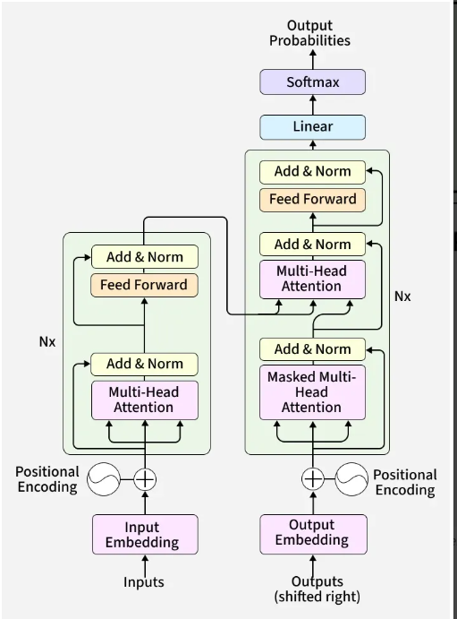
Transformer Architecture

Slide 3
Introduction
Transformers architecture is a deep learning model introduced in the paper “Attention Is All You Need” by Vaswani et al. in 2017. It has revolutionized the field of natural language processing (NLP) and has since been used in various other machine learning tasks due to its remarkable ability to capture long-range dependencies in data and its parallelizable nature. Here’s an overview of the key components and concepts of the Transformer architecture:

Slide 4
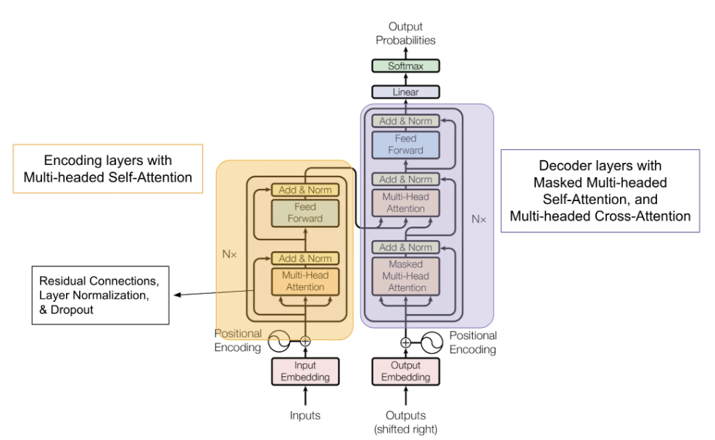

Slide 5
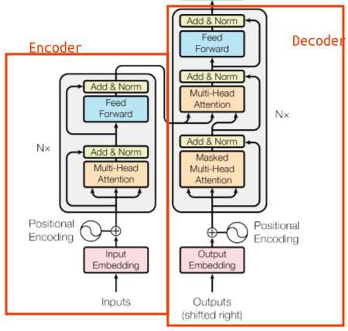
Transformer

Slide 6
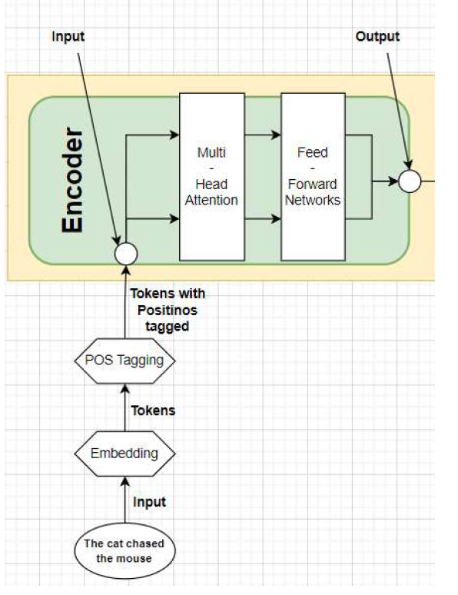
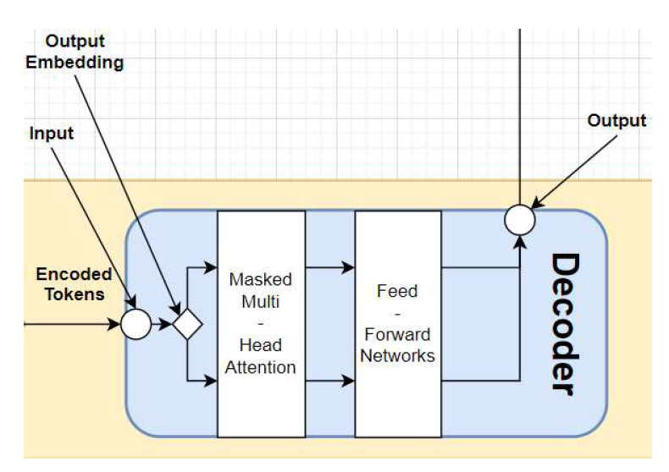

Slide 7
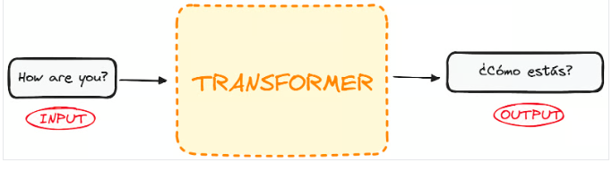
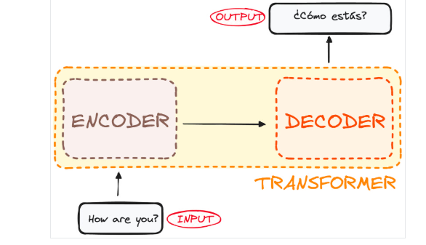
The encoder takes in our input and outputs a matrix representation of that input. For instance, the English sentence “How are you?”
The decoder takes in that encoded representation and iteratively generates an output. In our example, the translated sentence “¿Cómo estás?”

Slide 8
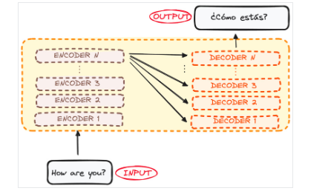
Both the encoder and the decoder are actually a stack with multiple layers (same number for each).
All encoders present the same structure, and the input gets into each of them and is passed to the next one.
All decoders present the same structure as well and get the input from the last encoder and the previous decoder.
Originally 6 encoders and 6 decoders, but we can replicate n layers

Slide 9

The Encoder WorkFlow

Slide 10
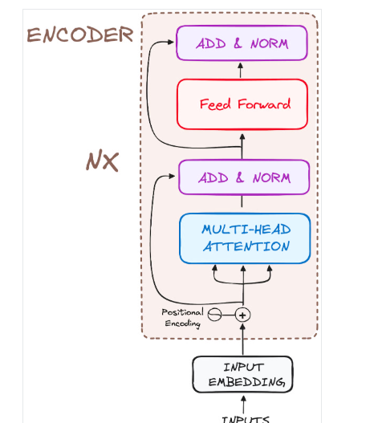
The Encoder
Is a fundamental component of the Transformer architecture.
Its primary function is to transform the input tokens into contextualized representations.
the Transformer encoder captures the context of each token with respect to the entire sequence.

Slide 11
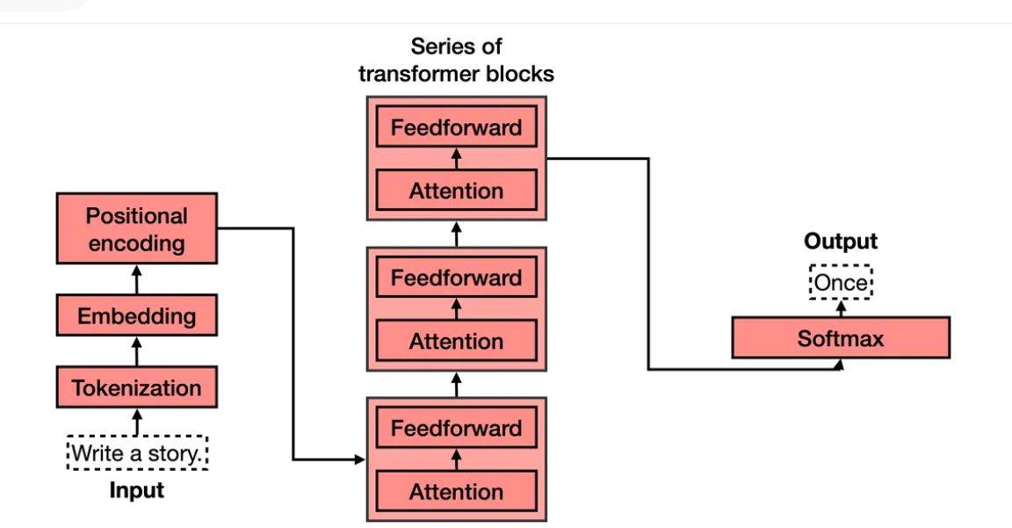

Slide 13

Tokenization
Tokenization consists of a large dataset of tokens, including all the words, punctuation signs, etc. The tokenization step takes every word, prefix, suffix, and punctuation signs, and sends them to a known token from the library.

Slide 14
from transformers import AutoTokenizer
tok = AutoTokenizer.from_pretrained("bert-base-uncased")
print(tok.tokenize("I love AI"))

Slide 15
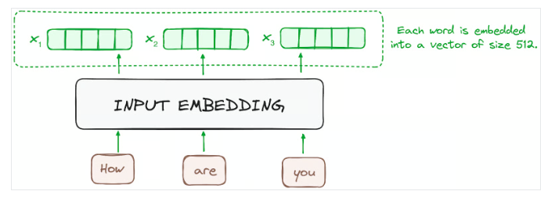
STEP 1 - Input Embeddings
The embedding happens at the bottom-most of encoder and begins by converting input tokens - words or subwords - into vectors using embedding layers. These embeddings capture the semantic meaning of the tokens and convert them into numerical vectors.
All the encoders receive a list of vectors, each of size 512 (fixed-sized). In the bottom encoder, that would be the word embeddings, but in other encoders, it would be the output of the encoder that’s directly below them.

Slide 16
Code to convert it in input Embeddings
import torch
from transformers import AutoTokenizer, AutoModel
tokenizer = AutoTokenizer.from_pretrained("bert-base-uncased")
model = AutoModel.from_pretrained("bert-base-uncased")
text = "I love AI"
inputs = tokenizer(text, return_tensors="pt")
embeddings = model.embeddings.word_embeddings(inputs["input_ids"])
print(embeddings.shape)

Slide 17
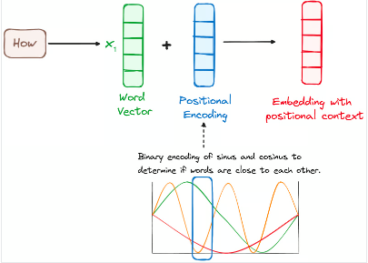
STEP 2 - Positional Encoding
use positional encodings added to the input embeddings to provide information about the position of each token in the sequence to understand the position of each word,
a combination of various sine and cosine functions are used to create positional vectors for sentences of any length.
each dimension is represented by unique frequencies and offsets of the wave, with the values ranging from -1 to 1, effectively representing each position.

Slide 18
import torch
import math
def positional_encoding(seq_len, d_model):
pe = torch.zeros(seq_len, d_model)
position = torch.arange(0, seq_len).unsqueeze(1)
div_term = torch.exp(
torch.arange(0, d_model, 2) * (-math.log(10000.0) / d_model)
)
pe[:, 0::2] = torch.sin(position * div_term)
pe[:, 1::2] = torch.cos(position * div_term)
return pe

Slide 19
# embeddings from previous step
# shape: (batch_size, seq_len, embed_dim)
seq_len = embeddings.size(1)
embed_dim = embeddings.size(2)
pe = positional_encoding(seq_len, embed_dim)
# Add positional encoding
embeddings = embeddings + pe.unsqueeze(0)
print(embeddings.shape)
print(embeddings)

Slide 20
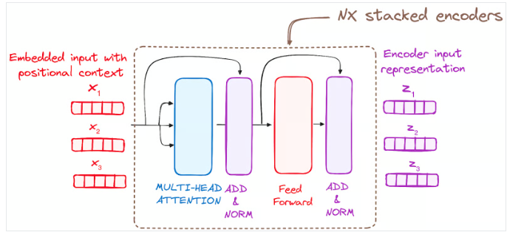
STEP 3 - Stack of Encoder Layers
The Transformer encoder 6 to N.
This layer serves to transform all input sequences into a continuous, abstract representation that encapsulates the learned information from the entire sequence. This layer comprises two sub-modules:
A multi-headed attention mechanism.
A fully connected network.
Additionally, it incorporates residual connections around each sublayer, which are then followed by layer normalization.

Slide 21
STEP 3.1 Multi-Headed Self-Attention Mechanism
It utilizes a specialized attention mechanism known as self-attention. This approach enables the models to relate each word in the input with other words. For instance, in a given example, the model might learn to connect the word “are” with “you”.
It computes attention scores based on:
A query is a vector that represents a specific word or token from the input sequence in the attention mechanism.
A key is also a vector in the attention mechanism, corresponding to each word or token in the input sequence.
Each value is associated with a key and is used to construct the output of the attention layer. When a query and a key match well, which basically means that they have a high attention score, the corresponding value is emphasized in the output.
This first Self-Attention module enables the model to capture contextual information from the entire sequence. Instead of performing a single attention function, queries, keys and values are linearly projected h times.

Slide 22
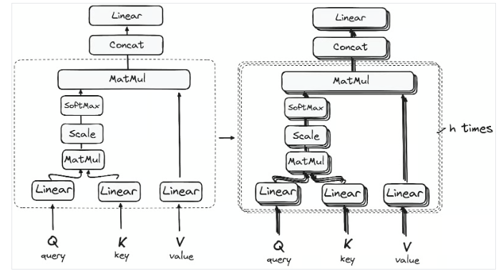

Slide 23
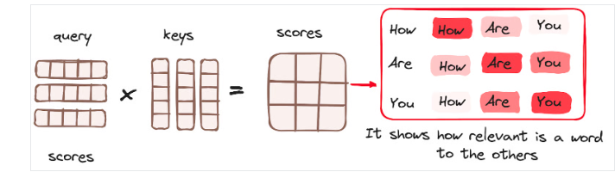
Matrix Multiplication (MatMul) - Dot Product of Query and Key
Once the query, key, and value vectors are passed through a linear layer, a dot product matrix multiplication is performed between the queries and keys, resulting in the creation of a score matrix.
This process effectively maps the queries to their corresponding keys.

Slide 24
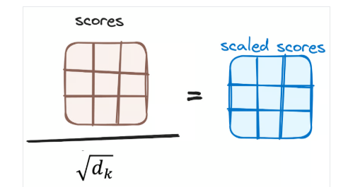
Reducing the Magnitude of attention scores
The scores are then scaled down by dividing them by the square root of the dimension of the query and key vectors. This step is implemented to ensure more stable gradients, as the multiplication of values can lead to excessively large effects.

Slide 25
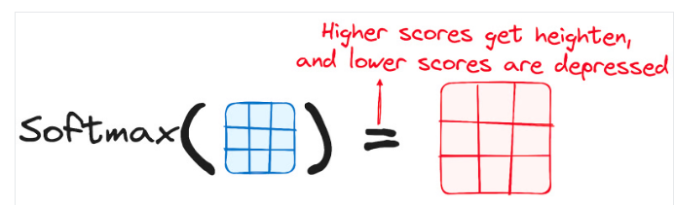
Applying Softmax to the Adjusted Scores
Subsequently, a softmax function is applied to the adjusted scores to obtain the attention weights. This results in probability values ranging from 0 to 1. The softmax function emphasizes higher scores while diminishing lower scores, thereby enhancing the model's ability to effectively determine which words should receive more attention.
The Encoder

Slide 26
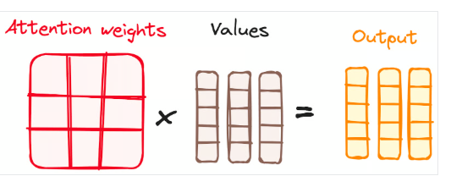
Combining Softmax Results with the Value Vector
The following step of the attention mechanism is that weights derived from the softmax function are multiplied by the value vector, resulting in an output vector.
In this process, only the words that present high softmax scores are preserved. Finally, this output vector is fed into a linear layer for further processing.
It is called as multi-self attention because breaking of the text in queries, keys and values (called as self-attention) and h times called multi-self-attention.

Slide 27
import torch
import torch.nn as nn
import math
class MultiHeadSelfAttention(nn.Module):
def __init__(self, embed_dim, num_heads):
super().__init__()
assert embed_dim % num_heads == 0
self.num_heads = num_heads
self.head_dim = embed_dim // num_heads
self.qkv = nn.Linear(embed_dim, embed_dim * 3)
self.fc = nn.Linear(embed_dim, embed_dim)
def forward(self, x):
B, T, C = x.shape # batch, tokens, embedding
qkv = self.qkv(x).reshape(B, T, 3, self.num_heads, self.head_dim)
q, k, v = qkv.permute(2, 0, 3, 1, 4)
# MatMul Happens & Reduces Attention Magnitude
scores = (q @ k.transpose(-2, -1)) / math.sqrt(self.head_dim)
attn = scores.softmax(dim=-1)
# combining softmax result
out = (attn @ v).transpose(1, 2).reshape(B, T, C)
return self.fc(out)

Slide 28
embed_dim = embeddings.size(2)
num_heads = 8
mha = MultiHeadSelfAttention(embed_dim, num_heads)
output = mha(embeddings)
print(output.shape)

Slide 29
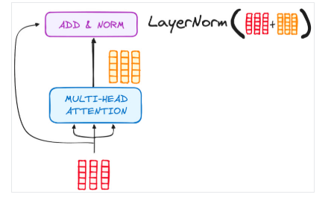
STEP 3.2 Normalization and Residual Connections
Each sub-layer in an encoder layer is followed by a normalization step. Also, each sub-layer output is added to its input (residual connection) to help mitigate the vanishing gradient problem, allowing deeper models. This process will be repeated after the Feed-Forward Neural Network too.

Slide 30
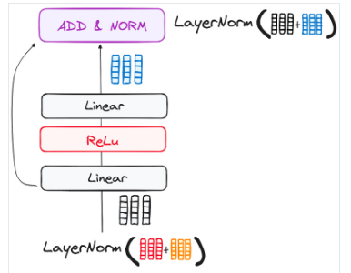
STEP 3.3 Feed-Forward Neural Network
The journey of the normalized residual output continues as it navigates through a pointwise feed-forward network, a crucial phase for additional refinement.
Picture this network as a duo of linear layers, with a ReLU activation nestled in between them, acting as a bridge. Once processed, the output embarks on a familiar path: it loops back and merges with the input of the pointwise feed-forward network.
This reunion is followed by another round of normalization, ensuring everything is well-adjusted and in sync for the next steps.

Slide 31
STEP 4 - Output of the Encoder
The output of the final encoder layer is a set of vectors, each representing the input sequence with a rich contextual understanding. This output is then used as the input for the decoder in a Transformer model.

Slide 32
The Decoder WorkFlow

Slide 33
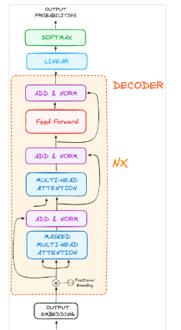
The decoder's role centers on crafting text sequences. Mirroring the encoder, the decoder is equipped with a similar set of sub-layers. It boasts two multi-headed attention layers, a pointwise feed-forward layer, and incorporates both residual connections and layer normalization after each sub-layer.

Slide 34
STEP 1 - Output Embeddings
At the decoder's starting line, the process mirrors that of the encoder. Here, the input first passes through an embedding layer

Slide 35
STEP 2 - Positional Encoding
Following the embedding, again just like the encoder, the input passes by the positional encoding layer. This sequence is designed to produce positional embeddings.
These positional embeddings are then channeled into the first multi-head attention layer of the decoder, where the attention scores specific to the decoder’s input are meticulously computed.

Slide 36
STEP 3 - Stack of Decoder Layers
The decoder consists of a stack of identical layers (6 in the original Transformer model). Each layer has three main sub-components:
STEP 3.1 Masked Self-Attention Mechanism
This is similar to the self-attention mechanism in the encoder but with a crucial difference: it prevents positions from attending to subsequent positions, which means that each word in the sequence isn't influenced by future tokens.
For instance, when the attention scores for the word "are" are being computed, it's important that "are" doesn't get a peek at "you", which is a subsequent word in the sequence.

Slide 37
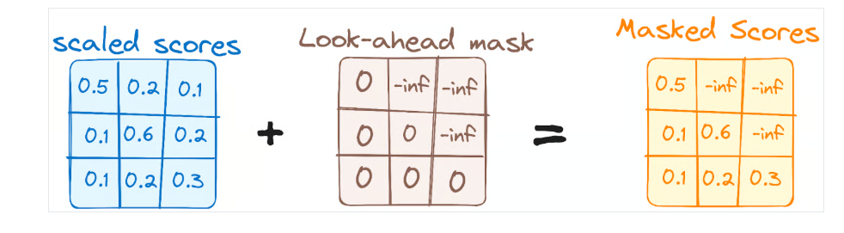
This masking ensures that the predictions for a particular position can only depend on known outputs at positions before it.

Slide 38
STEP 3.2 - Encoder-Decoder Multi-Head Attention or Cross Attention
In the second multi-headed attention layer of the decoder, we see a unique interplay between the encoder and decoder's components. Here, the outputs from the encoder take on the roles of both queries and keys, while the outputs from the first multi-headed attention layer of the decoder serve as values.
This setup effectively aligns the encoder's input with the decoder's, empowering the decoder to identify and emphasize the most relevant parts of the encoder's input.
Following this, the output from this second layer of multi-headed attention is then refined through a pointwise feedforward layer, enhancing the processing further.

Slide 39
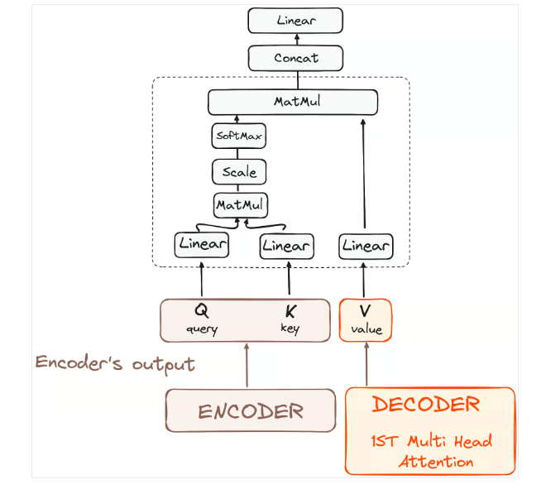
In this sub-layer, the queries come from the previous decoder layer, and the keys and values come from the output of the encoder. This allows every position in the decoder to attend over all positions in the input sequence, effectively integrating information from the encoder with the information in the decoder.

Slide 40
STEP 3.3 Feed-Forward Neural Network
Similar to the encoder, each decoder layer includes a fully connected feed-forward network, applied to each position separately and identically.

Slide 41
STEP 4 Linear Classifier and Softmax for Generating Output Probabilities
The journey of data through the transformer model culminates in its passage through a final linear layer, which functions as a classifier.
The size of this classifier corresponds to the total number of classes involved (number of words contained in the vocabulary). For instance, in a scenario with 1000 distinct classes representing 1000 different words, the classifier's output will be an array with 1000 elements.
This output is then introduced to a softmax layer, which transforms it into a range of probability scores, each lying between 0 and 1. The highest of these probability scores is key,its corresponding index directly points to the word that the model predicts as the next in the sequence.

Slide 42
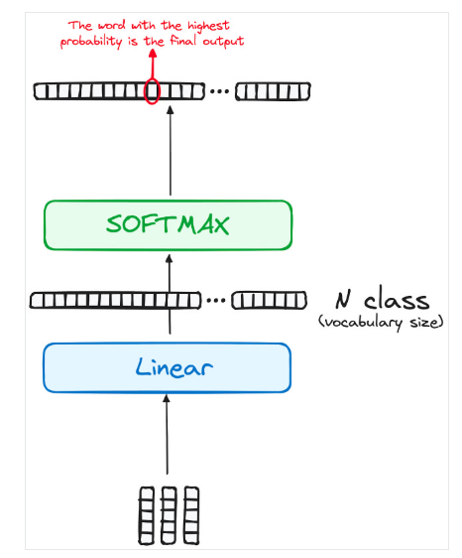

Slide 43
Normalization and Residual Connections
Each sub-layer (masked self-attention, encoder-decoder attention, feed-forward network) is followed by a normalization step, and each also includes a residual connection around it.

Slide 44
Output of the Decoder
The final layer's output is transformed into a predicted sequence, typically through a linear layer followed by a softmax to generate probabilities over the vocabulary.
The decoder, in its operational flow, incorporates the freshly generated output into its growing list of inputs, and then proceeds with the decoding process. This cycle repeats until the model predicts a specific token, signaling completion.
The token predicted with the highest probability is assigned as the concluding class, often represented by the end token.

Slide 45
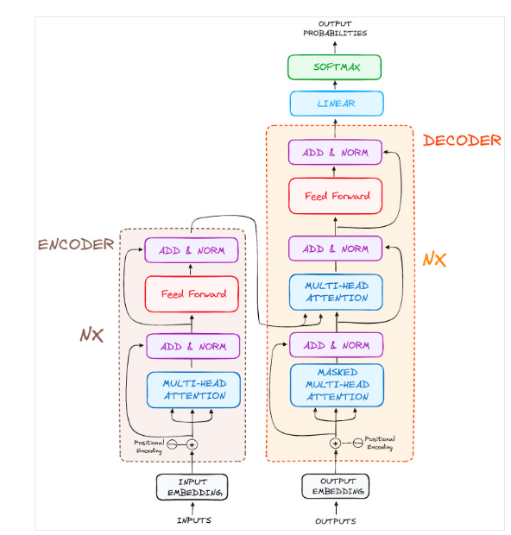

Slide 46
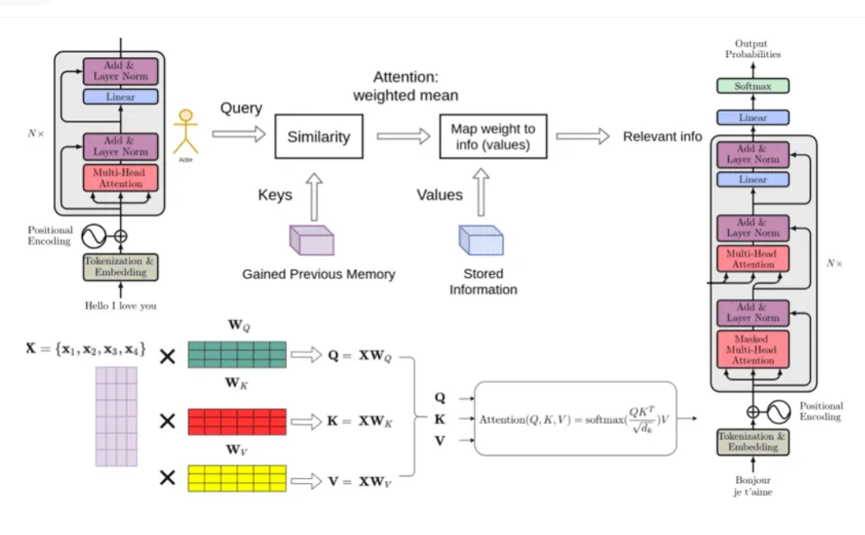

Slide 47

A complete Example

Slide 48
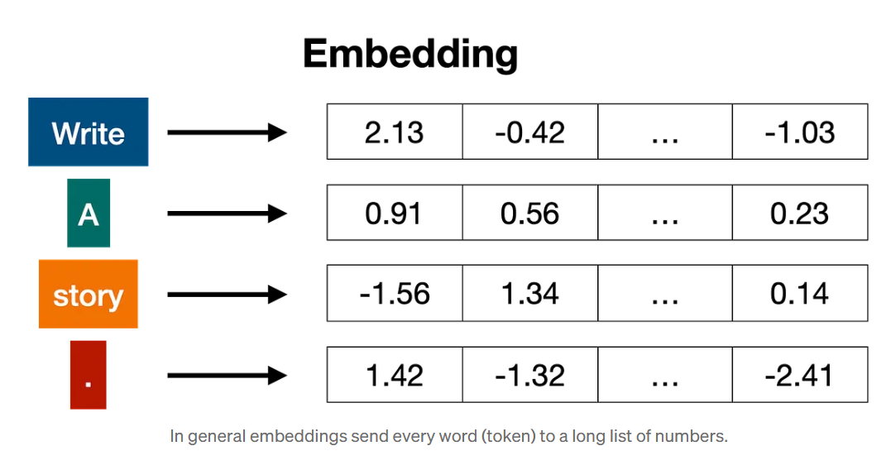
Embedding
Once the input has been tokenized, it’s time to turn words into numbers. For this, we use an embedding.

Slide 49
Positional encoding
Once we have the vectors corresponding to each of the tokens in the sentence, the next step is to turn all these into one vector to process. The most common way to turn a bunch of vectors into one vector is to add them, componentwise. That means, we add each coordinate separately. For example, if the vectors (of length 2) are [1,2], and [3,4], their corresponding sum is [1+3, 2+4], which equals [4, 6].

Slide 50
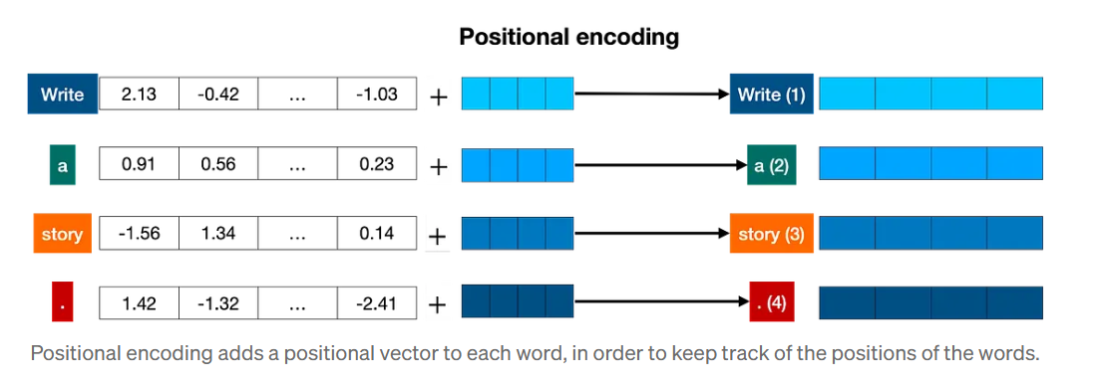

Slide 51
Transformer block
Let’s recap what we have so far. The words come in and get turned into tokens (tokenization), tokenized words are turned into numbers (embeddings), then order gets taken into account (positional encoding). This gives us a vector for every token that we input to the model. Now, the next step is to predict the next word in this sentence. This is done with a really really large neural network, which is trained precisely with that goal, to predict the next word in a sentence.

Slide 52
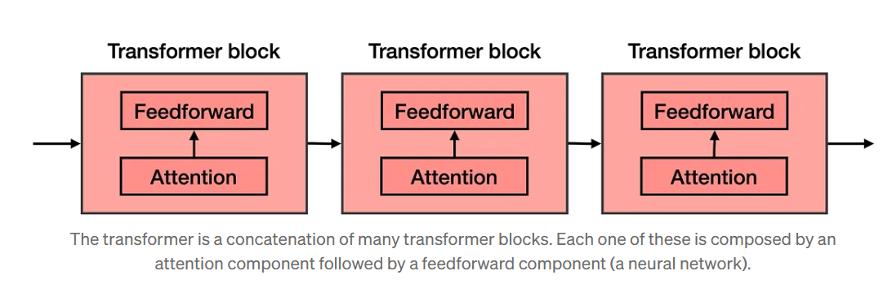
The attention component is added at every block of the feedforward network. Therefore, if you imagine a large feedforward neural network whose goal is to predict the next word, formed by several blocks of smaller neural networks, an attention component is added to each one of these blocks. Each component of the transformer, called a transformer block, is then formed by two main components:
The attention component.
The feedforward component.

Slide 53
Attention
The next step is attention. As you learned attention mechanism deals with a very important problem: the problem of context. Sometimes, as you know, the same word can be used with different meanings.
Attention is a very useful technique that helps language models understand the context. In order to understand how attention works, consider the following two sentences:
Sentence 1: The bank of the river.
Sentence 2: Money in the bank.
The word ‘bank’ appears in both, but with different definitions. The computer has no idea of this, so we need to somehow inject that knowledge into it. What can help us? Well, it seems that the other words in the sentence can come to our rescue. For the first sentence, the words ‘the’, and ‘of’ do us no good. But the word ‘river’ is the one that is letting us know that we’re talking about the land at the side of the river. Similarly, in sentence 2, the word ‘money’ is the one that is helping us understand that the word ‘bank’ is now referring to the institution that holds money.

Slide 54
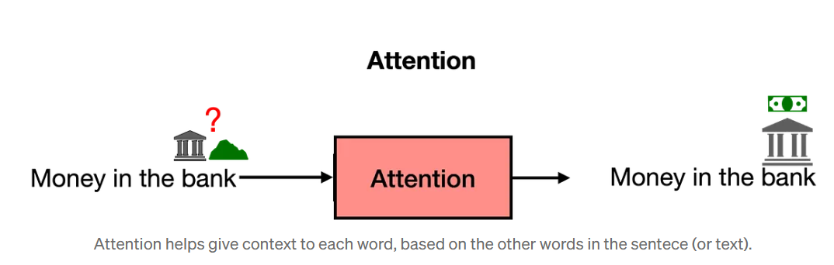
In short, what attention does is it moves the words in a sentence (or piece of text) closer in the word embedding. In that way, the word “bank” in the sentence “Money in the bank” will be moved closer to the word “money”. Equivalently, in the sentence “The bank of the river”, the word “bank” will be moved closer to the word “river”. That way, the modified word “bank” in each of the two sentences will carry some of the information of the neighboring words, adding context to it.
The attention step used in transformer models is actually much more powerful, and it’s called multi-head attention. In multi-head attention, several different embeddings are used to modify the vectors and add context to them. Multi-head attention has helped language models reach much higher levels of efficacy when processing and generating text.

Slide 55
The Softmax Layer
Now that you know that a transformer is formed by many layers of transformer blocks, each containing an attention and a feedforward layer, you can think of it as a large neural network that predicts the next word in a sentence. The transformer outputs scores for all the words, where the highest scores are given to the words that are most likely to be next in the sentence.
The last step of a transformer is a softmax layer, which turns these scores into probabilities (that add to 1), where the highest scores correspond to the highest probabilities. Then, we can sample out of these probabilities for the next word. In the example below, the transformer gives the highest probability of 0.5 to “Once”, and probabilities of 0.3 and 0.2 to “Somewhere” and “There”. Once we sample, the word “once” is selected, and that’s the output of the transformer.

Slide 56
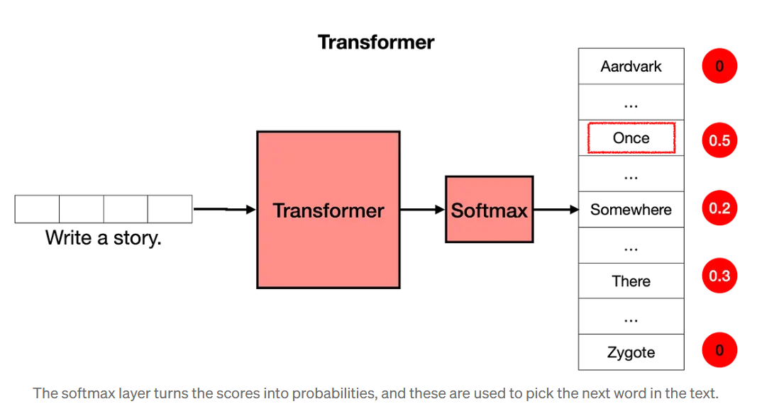

Slide 57
Post Training
Now that you know how transformers work, we still have a bit of work to do. Imagine the following: You ask the transformer “What is the capital of Algeria?”. We would love for it to answer “Algiers”, and move on. However, the transformer is trained on the entire internet. The internet is a big place, and it’s not necessarily the best question/answer repository. Many pages, for example, would have long lists of questions without answers. In this case, the next sentence after “What is the capital of Algeria?” could be another question, such as “What is the population of Algeria?”, or “What is the capital of Burkina Faso?”. The transformer is not a human who thinks about their responses, it simply mimics what it sees on the internet (or any dataset that has been provided). So how do we get the transformer to answer questions?
The answer is post-training. In the same way that you would teach a person to do certain tasks, you can get a transformer to perform tasks. Once a transformer is trained on the entire internet, then it is trained again on a large dataset which corresponds to lots of questions and their respective answers. Transformers (like humans), have a bias towards the last things they’ve learned, so post-training has proven a very useful step to help transformers succeed at the tasks they are asked to.
Post-training also helps with many other tasks. For example, one can post-train a transformer with large datasets of conversations, in order to help it perform well as a chatbot, or to help us write stories, poems, or even code.

Slide 58
Building the Transformer Model with PyTorch
Importing the libraries and modules.
Defining the basic building blocks: Multi-head Attention, Position-Wise Feed-Forward Networks, Positional Encoding.
Building the Encoder block.
Building the Decoder block.
Combining the Encoder and Decoder layers to create the complete Transformer network.
https://colab.research.google.com/drive/17l4hJ5Scj4UJEKfynHI_Fvs9G0W7vslv?authuser=7#scrollTo=717GV2xJL8Kz
Building the Transformer Model with PyTorch.ipynb

Slide 59
Component | Description | Purpose
Multi-Head Attention | Mechanism to focus on different parts of the input | Captures dependencies across different positions in the sequence
Feed-Forward Networks | Position-wise fully connected layers | Transforms the attention outputs, adding complexity
Positional Encoding | Adds positional information to embeddings | Provides sequence order context to the model
Layer Normalization | Normalizes inputs to each sub-layer | Stabilizes training, improves convergence
Residual Connections | Shortcuts between layers | Helps in training deeper networks by minimizing gradient issues
Dropout | Randomly zeroes some network connections | Prevents overfitting by regularizing the model

Slide 60
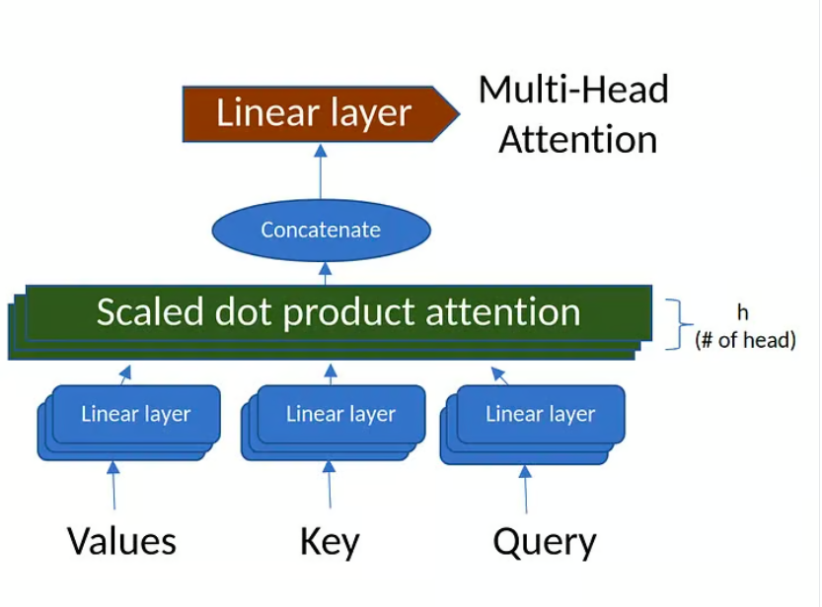

Slide 61
https://pypi.org/project/transformers/
https://colab.research.google.com/drive/1VQfAQquwaouhaBu--0QXJyYOVvgWHZUo?authuser=7#scrollTo=ua5pPAcQq88R
Transformers.ipynb

Slide 62

Real-Life Transformer Models

Slide 63
BERT
Google's 2018 release of BERT, an open-source natural language processing framework, revolutionized NLP with its unique bidirectional training, which enables the model to have more context-informed predictions about what the next word should be.
By understanding context from all sides of a word, BERT outperformed previous models in tasks like question-answering and understanding ambiguous language. Its core uses Transformers, connecting each output and input element dynamically.
BERT, pre-trained on Wikipedia, excelled in various NLP tasks, prompting Google to integrate it into its search engine for more natural queries. This innovation sparked a race to develop advanced language models and significantly advanced the field's ability to handle complex language understanding.
To know more about BERT, you can go check our separate article that introduces the BERT model.

Slide 64
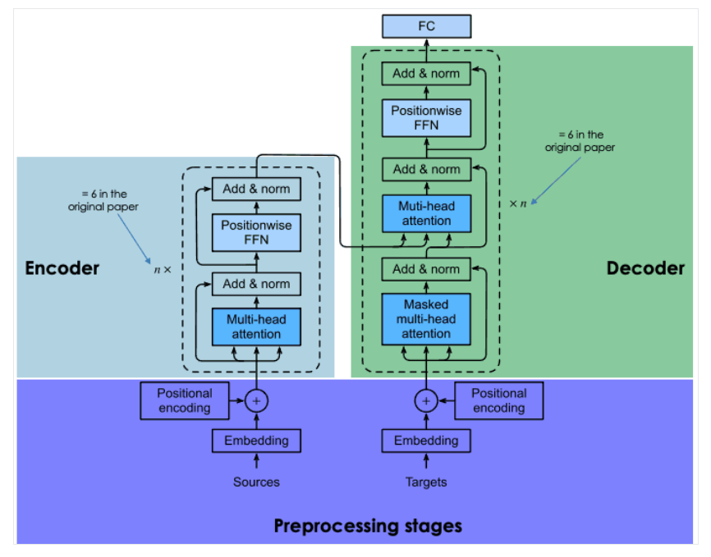

Slide 65
What is BERT Used for?
Question answering. BERT has been one of the first transformer-powered chatbots, delivering impressive results.
Sentiment analysis. For example, BERT has been successful in predicting positive or negative punctuation for movie reviews.
Text generation. A precursor of next-generation chatbots, BERT was already able to create long texts with simple prompts.
Summarizing text. Equally, BERT was able to read and summarize texts from complex domains, including law and healthcare.
Language translation. BERT has been trained on data written in multiple languages. That makes it a multilingual model, which translates into great suitability for language translation.
Autocomplete tasks. BERT can be used for autocomplete tasks, for example, in emails or messaging services.

Slide 66

Real-World Applications of BERT

Slide 67
BERT’s variants and adaptations
RoBERTa. Short for “Robustly Optimized BERT Approach'', RoBERTa is a BERT variant created by Meta in collaboration with Washington University. Considered a more powerful version than the original BERT, RoBERTa was trained with a dataset 10 times bigger than the one used to train BERT. As for its architecture, the most significant difference is the use of dynamic masking learning instead of static masking learning. This technique, which involved duplicating training data and masking it 10 times, each time with a different mask strategy, allowed RoBERTa to learn more robust and generalizable representations of words.
DistilBERT. Since the launch of the first LLMs in the late 2010s, there has been a consolidated trend of building bigger and heavier LLMs. This makes sense, as there seems to be a direct relationship between model size and model accuracy. Yet, it’s also true that the bigger the model, the more resources it requires to run, and hence, fewer people can afford to use it. DistilBERT aims at making BERT more accessible by offering a smaller, faster, cheaper, and lighter variant. Based on the architecture of the original BERT, DistilBERT uses knowledge distillation techniques during pre-training to reduce the size by 40% while retaining 97% of its language understanding capabilities and being 60% faster.
ALBERT. Stands for A Lite BERT, ALBERT was specifically designed to increase the efficiency of BERTlarge during pre-training. As training bigger models often results in memory limitations, longer training times, and unexpected model degradation, ALBERT creators developed two parameter-reduction techniques to reduce memory consulting and increase speed during training.

Slide 68
Fine-tuning BERT for specific tasks
list of fine-tuned versions of BERT:
BERT-base-chinese. A version of BERTbase trained for NLP tasks in Chinese
BERT-base-NER. A version of BERTbase customized for named entity recognition
Symps_disease_bert_v3_c41. A symptom-to-disease classification model for a natural language chatbot.
BERT for Patents. is a model trained by Google on 100M+ patents worldwide. It is based on BERTlarge.

Slide 69
BERT’s Limitations
BERT comes with the traditional limitations and problems associated with LLMs. The predictions of BERT are always based on the quantity and quality of data used for training it. If training data is limited, poor, and biased, BERT may throw inaccurate, harmful results or even so-called LLM hallucinations.
In the case of the original BERT, this is even more likely, as the model was trained without Reinforcement Learning from Human Feedback (RLHF), a standard technique used by more advanced models, like ChatGPT, LLaMA 2, and Google Bard, to enhance AI safety. RLHF involves using human feedback to monitor and steer the learning process of the LLM during training, thereby ensuring effective, safer, and trustful systems.
Furthermore, although it can be considered a small model compared to other state-of-the-art LLMs, like ChatGPT, it still requires a considerable amount of computing power to run it, let alone train it from scratch. Therefore, developers with limited resources may not be able to use it.

Slide 71

Thank You

